Slide 1
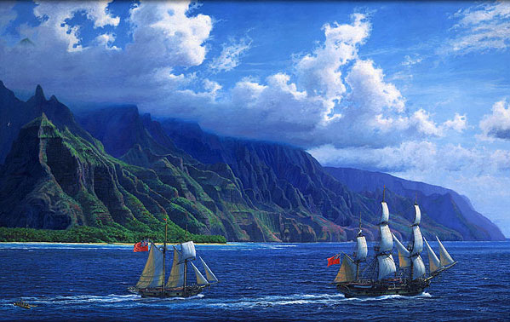
European Nations Settle in North America

Slide 2

Look what Spain Started…
Spain’s colonization of the Americas made other European nations desire to do the same.

Slide 3
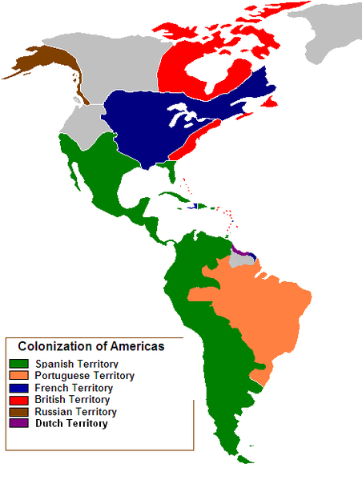
Claiming North America
French, English, and Dutch
  Give up on trade route to Asia and decide to colonize North America

Slide 4
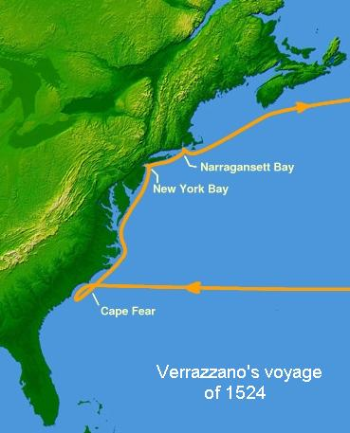
France
Verazzano – Italian in service of France
  1524 - Looking for the East Indies, accidentally finds New York

Slide 5
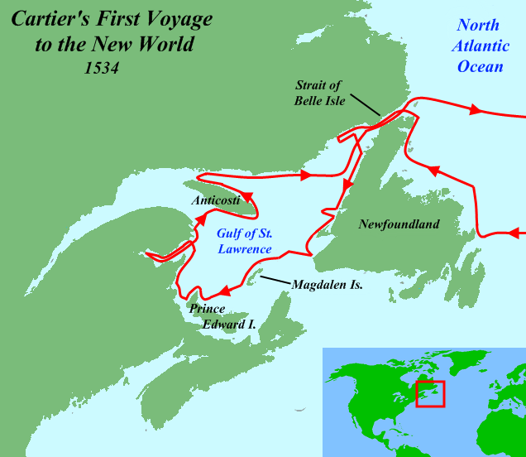

France
Jacques Cartier – French
  Discovers and names Gulf of St. Lawrence
  Founded Montreal

Slide 6
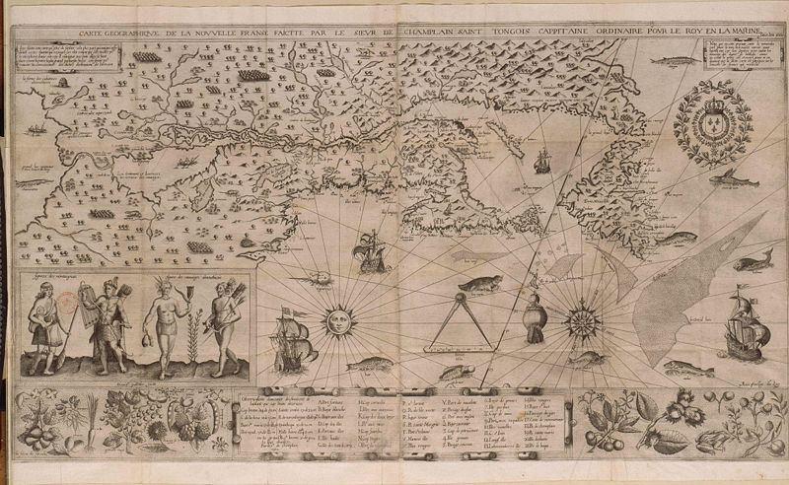
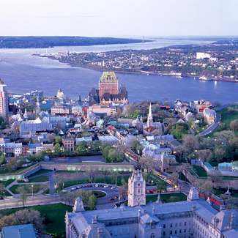
France
Samuel de Champlain
  1608 – founded Quebec on the St. Lawrence
    Becomes basis for New France

Slide 7
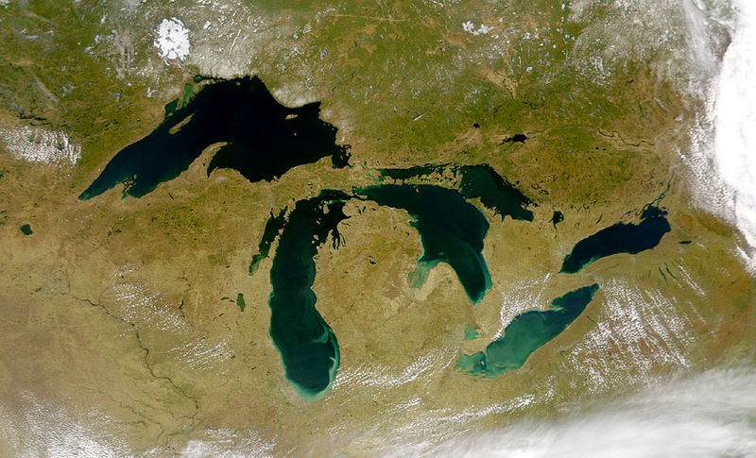
France
Jacques Marquette and Louis Joliet
  1673 – explored the Great Lakes

Slide 8
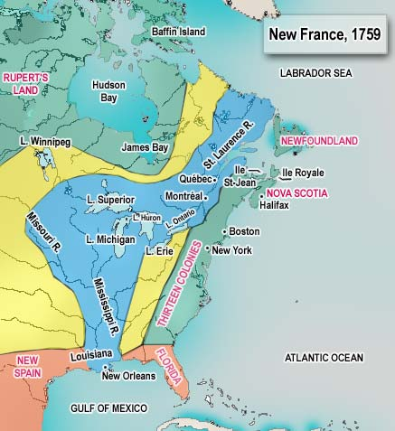
France
Sieur de La Salle
  Continued exploration of the Mississippi and founded Louisiana in honor of Louis XIV
Although large, not many French colonists
  65,000

Slide 9
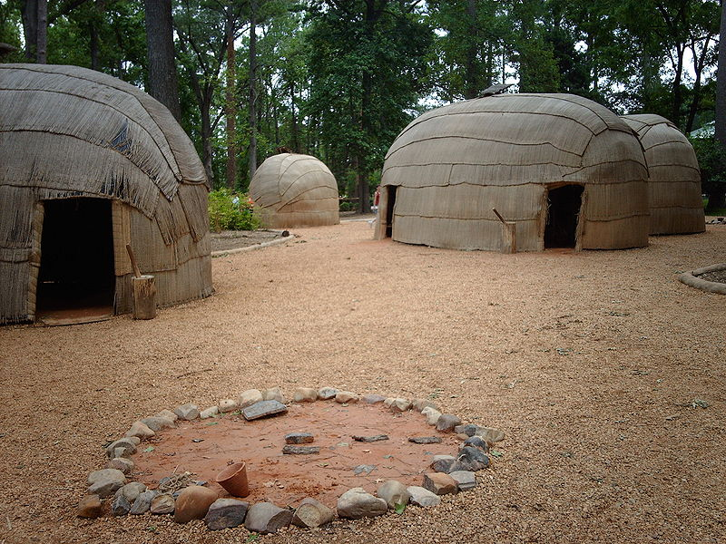
England
1607 – English settle Jamestown in Virginia.
  Not a very good first attempt
  Too many obsessed with gold
  Successful after learning to cultivate tobacco
    Settled Charles Towne in 1670

Slide 10
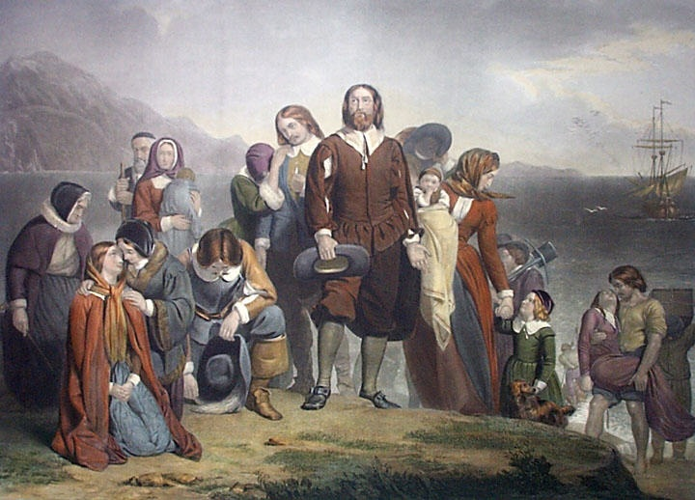
England
New England
  1620 – Pilgrims founded Plymouth in Massachusetts.
    Why?
      religion

Slide 11
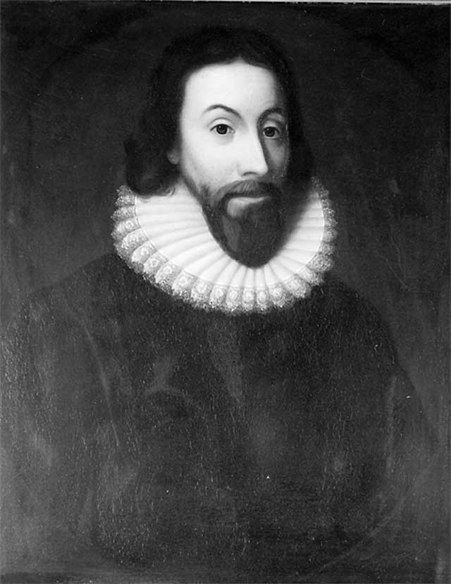
England
1630 – Puritans come for the same reason
Founded the Massachusetts Bay Colony
    Want to build a Puritan “city upon a hill”
    John Winthrop:
      “For we must consider that we shall be as a city upon a hill. “

Slide 12
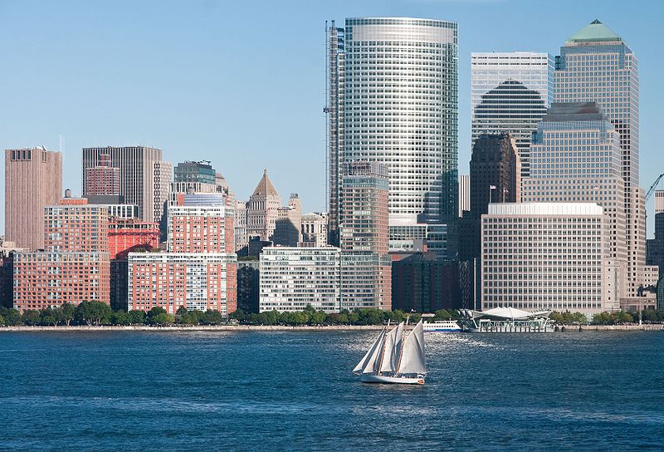
The Netherlands
1609 – Henry Hudson (actually English)
  Again, looking for Asia
  Hudson River, Hudson Bay, and Hudson Strait
  Establish New Netherland

Slide 13
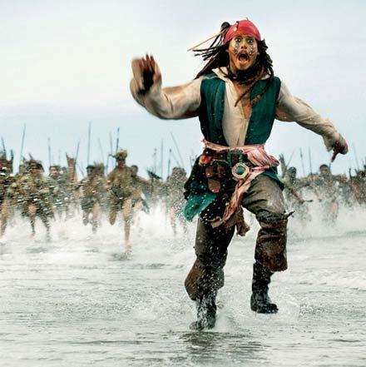
Caribbean
France
  Haiti, Guadeloupe, and Martinique
England
  Barbados and Jamaica (Port Royal is here…)
Netherlands
  Netherland Antilles and Aruba

Slide 14
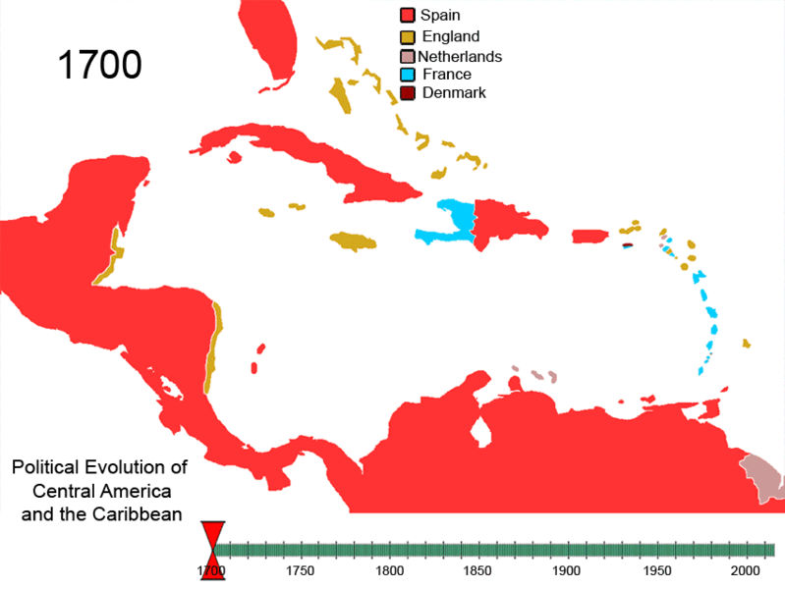

Slide 15
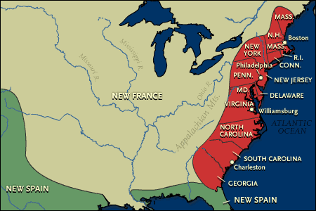
Everyone Starts Fighting
English
  1664 - Bloodless battle sees England take over New Netherland
    Renamed New York
  England now has a stronghold on the east coast.

Slide 16
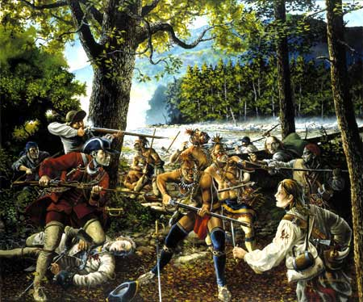
French and Indian War
England continues into the interior of NA
  Fight with the French from 1754-1763
    AKA Seven Years’ War
  England wins and gets more land

Slide 17
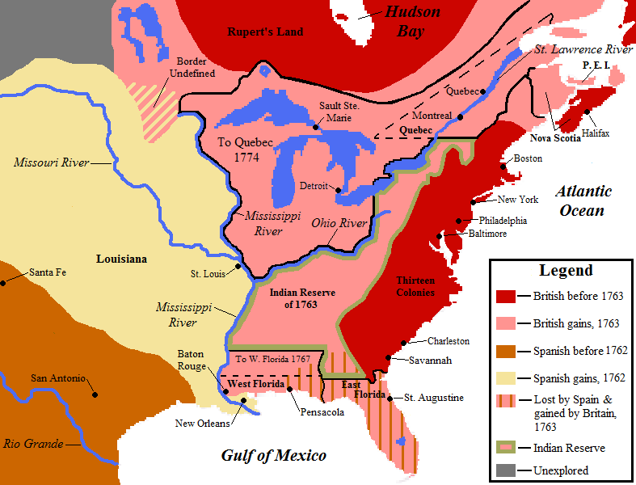

Slide 18
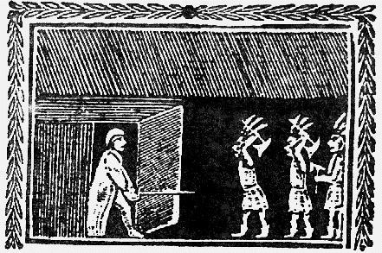
Native Americans
Thriving trade
  Furs for:
    Guns, hatchets, mirrors, and beads
Conflicts begin
  English constantly push Natives west
  Religion was also a problem
  1675 – King Philip’s War
    Guerilla warfare from the Natives, but English win.

Slide 19
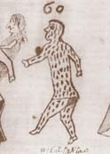
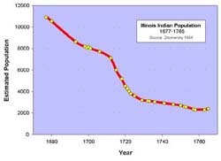
Native Americans
Diseases
  The "white man" diseases…measles, chicken pox, typhus, typhoid fever, dysentery, scarlet fever
  Smallpox was the worst
  Why was this good for the Europeans?
  Why was this a problem for the Europeans?

Slide 20
If You Sailed with a Great Explorer…
What qualities make a good explorer/leader?
Read the Explorer biography cards.
Rank each Explorer based on their effectiveness as a leader/explorer (1-8, one being the best and 8 the least).
Take notes on things the explorer did and strong qualities he possessed.
Also try and guess the correct identity of the explorer based on the biography explanation.

