Slide 1
The Ottomans

Slide 2
Maps can help sometimes…

Slide 3
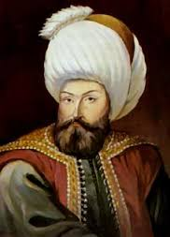
Osman
Successful Ghazi g “Warrior for Islam”
Followers became the Ottomans
Built Muslim state in modern day Turkey between 1300-1326
Cannons and gunpowder made him successful
His son, Orkhan, became
sultan g “one with power”

Slide 4
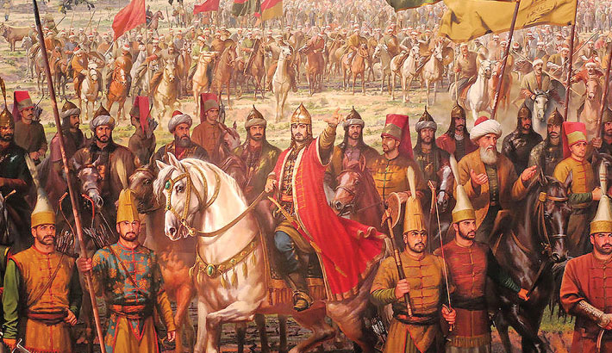
Expansion
Mehmed I and Murad II expand the empire
Defeated Venetians
Invaded Hungary
Mehmed II
Sacks Constantinople (Woohoo!)
Opened Constantinople to all religions

Slide 5
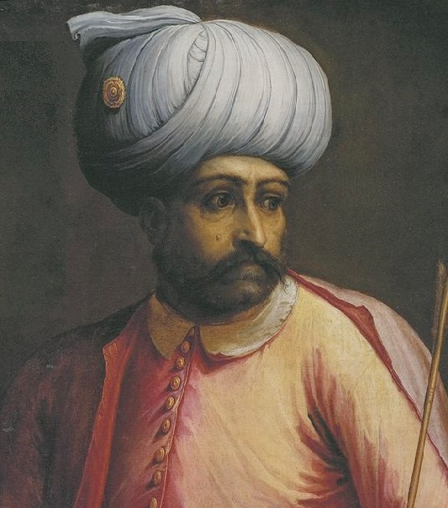
Expanding Further
Selim the Grim – 1512
Defeats the Safavids (Persia)
Took Syria and Palestine
Captured Mecca & Medina (Woah, Islam!)
Moved into North Africa!
He looks really happy g

Slide 6
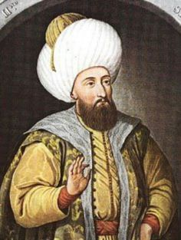
Suleiman the Lawmaker (or the Magnificent)
Selim the Grim’s son
Guess what…He expanded the empire!
Conquered Belgrade
Tripoli (N. Africa)
Dominated the Mediterranean
He’s kind of a big deal g

Slide 7
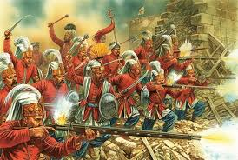
Suleiman’s Society
Law Code
Reduced taxes & bureaucracy
Janissaries
Elite soldiers loyal to the sultan
Devshirme g Process of drafting boys from conquered Christian territories

Slide 8
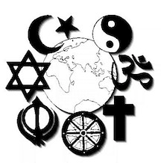
According to Islamic law…
Freedom of worship must be allowed
Millets g religious communities
Allowed follow own religious practices & laws
Why is this a good idea?

Slide 9
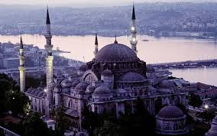
Basically the Ottoman Renaissance
During Reign of Suleiman…
Poetry, art, history, geography, mathematics, astronomy…etc.
Took influences from Persia and Arabia
Mosque of Suleiman by Sinan

Slide 10
Decline of an Empire
Suleiman had 3 sons
Killed one, drove one into exile, left the empire to the most incompetent
Causes weak line of sultans
Ottomans last into 20th century
Had limited power and influence

Slide 11
Safavids
They’re from Persia

Slide 12
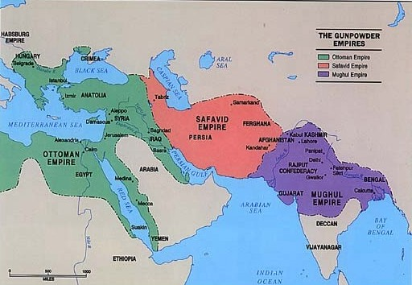
Who are they?
Shi’ite Muslim dynasty (from Persia)

Slide 13
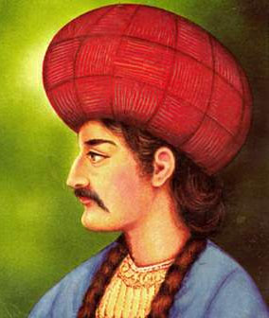
Important (Early) People…
Isma’il (Kinda like Ishmael but not)
Seized Iran
Took Title of Shah g “King”
Defeated by Selim the Grim (1514)
Tahmasp
Adopted artillery after Ottoman defeat
Expanded the empire!!
To the Caucasus Mts.
Brought Christians under rule

Slide 14
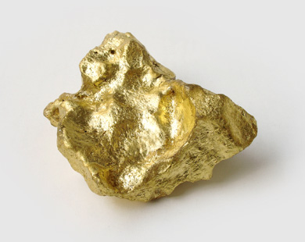
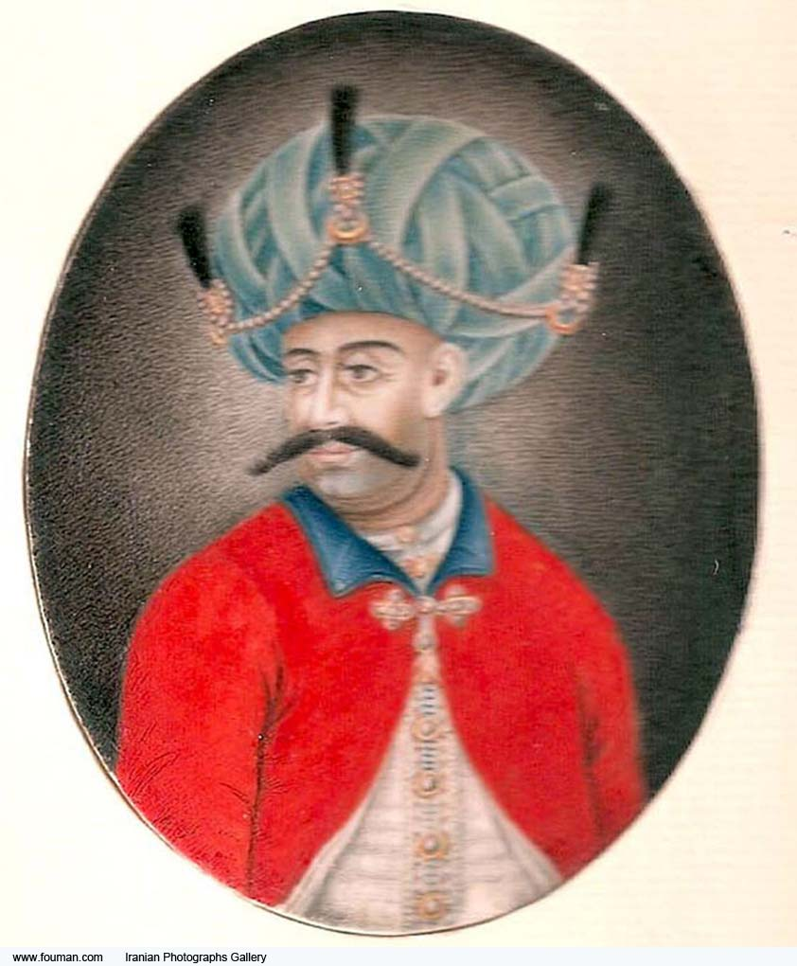
The Golden Age
That’s gold g
Shah Abbas (1587)
Made some changes…
Limited military power
Created 2 new armies loyal to him
What does that sound like???
Gov’t
Punished corruption severely
Hired foreigners to lead
Accepted Christians
To encourage trade with Europe
Moved capital to Esfahan

Slide 15
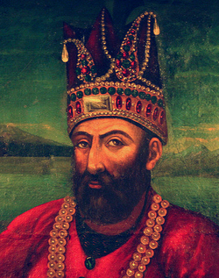
Dynastic Decline
Abbas blinded or killed his ablest sons
Who does this sound like??
Nadir Shah
Cruel ruler…was murdered…
I feel like he looks evil g

