Slide 1
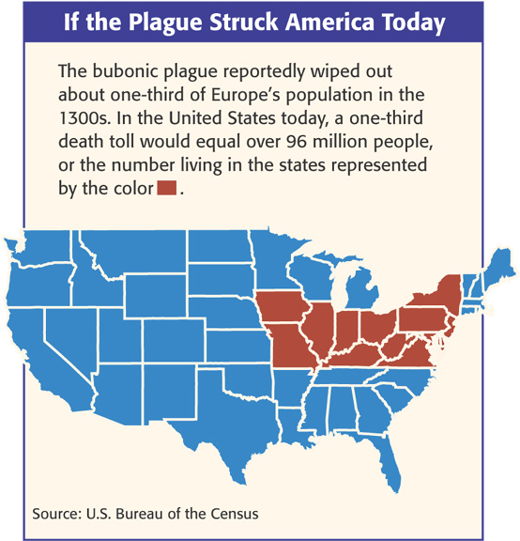
The Plague!
Known as the Black Death
One-third of the population of Europe died (20-25 million)
4 million died in SW Asia
35 million in China!

Slide 2
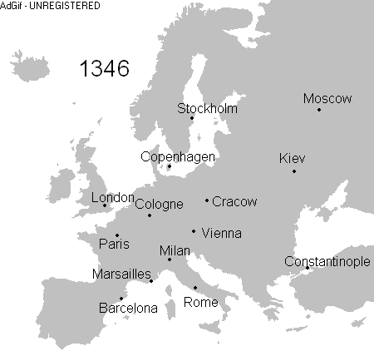
Origins?
Where did the plague begin and how did it spread?
Began in Asia and spread through trade
Rats and fleas

Slide 3
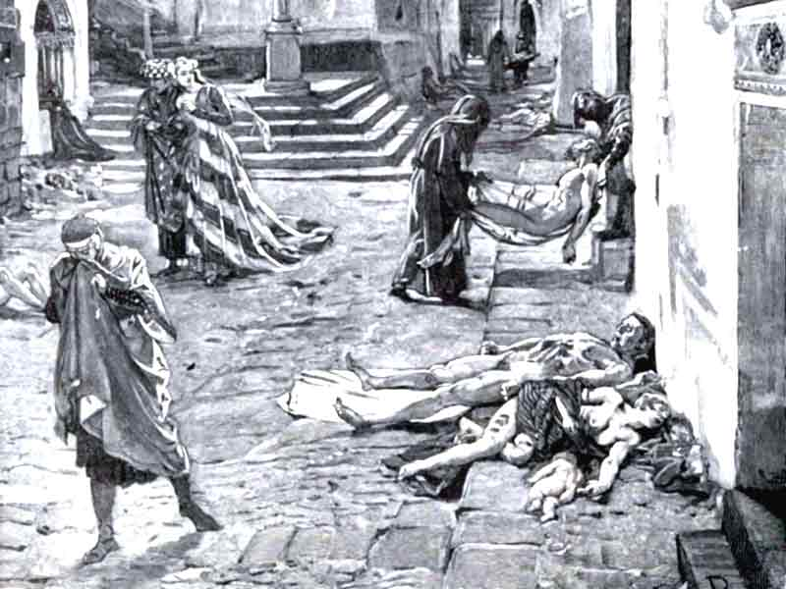
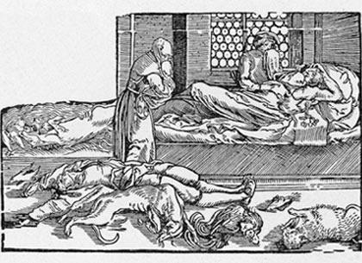
The Plague
Painful swellings called buboes in the lymph nodes (armpit & groin)
Purplish or black spots on skin
Extremely high fever, chills, delirium, and in most cases death

Slide 4
Primary Sources of the plague
Epidemic terrifies and rips apart society
“This scourge had implanted so great a terror in the hearts of men and women that brothers abandoned brother, uncles their nephews, sisters their brothers, and in many cases wives deserted their husbands. But even worse,…fathers and mothers refused to nurse and assist their own children.” – Giovanni Boccaccio The Decameron

Slide 5
Why is this happening?
Why is this happening to us???
Vapors from earthquakes?
Alignment of planets and stars?
Divine punishment for sins?
Poisoned by the Jews?

Slide 6
Impact of Plague on Jews
Impact on Jews in Europe
Became scapegoats
Accused of poisoning the town wells
Persecuted in Spain
Worst in Germany (Holy Roman Empire)
60 Jewish communities in Germany wiped out
Many fled to Poland b/c king provided them protection

Slide 7
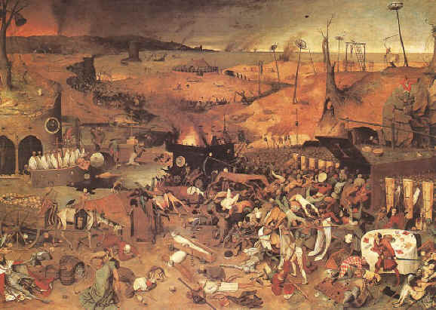
Effects of the Plague
Town populations fall
Trade declines
Prices rise
Some serfs leave manors for paying work (decline of the manorial system)
Many Jews blamed and killed

Slide 8
How did the plague affect the Church?
When prayer and penance failed to stop the plague, the Church lost prestige.

