Slide 1
Trade Routes

Slide 2
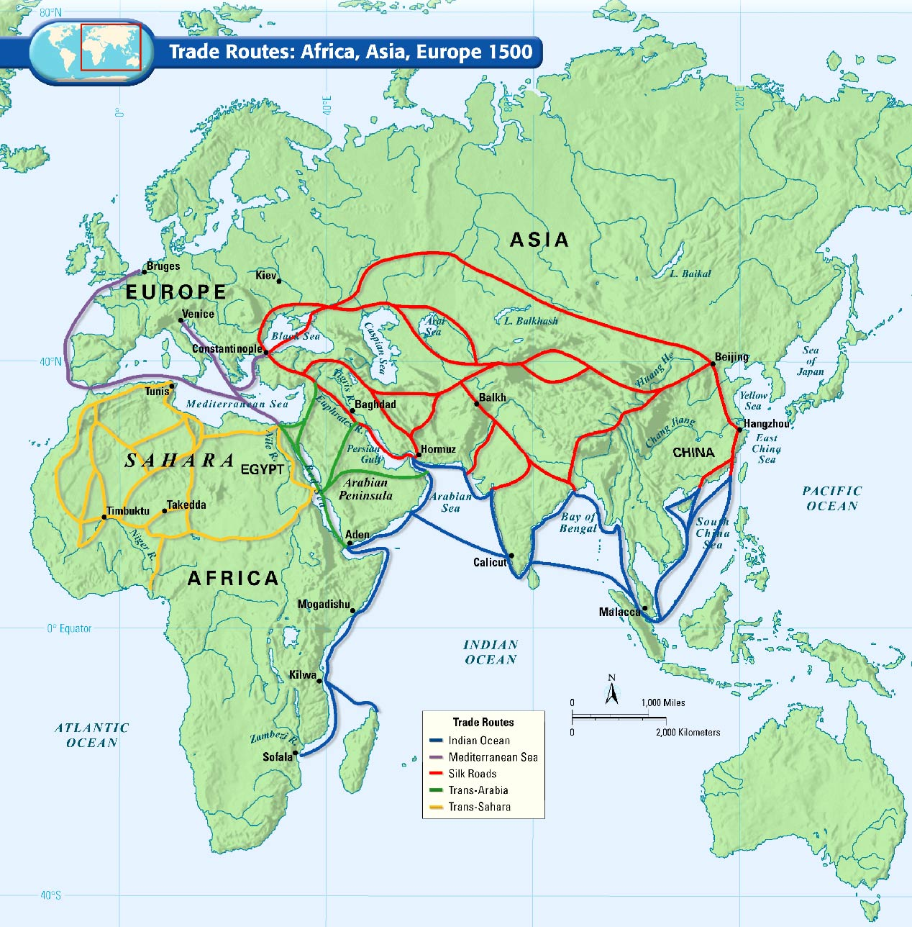

Slide 3
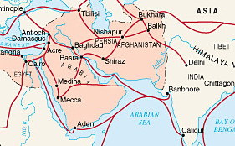
Trans-Arabic
Who was involved?
Sassanid Empire
Arabia
Byzantine Empire
Mode of Transportation
Camel caravans
What was exchanged?
Notes:
Exchange Items to discuss:
East Asia - silk, gems, dyes, cotton cloth
Arabia- incense, spices
Southwest Asia - wool, gold, silver

Slide 4
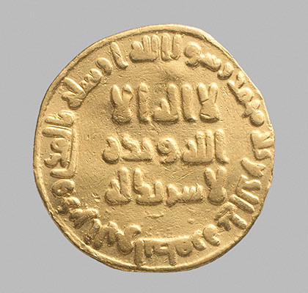
Trans-Arabic
Societal Impacts
Became a hub for international trade
Spread of Islam and ideals throughout various areas of Asia, Africa, and Europe
Begin using coins as means of exchange

Slide 5
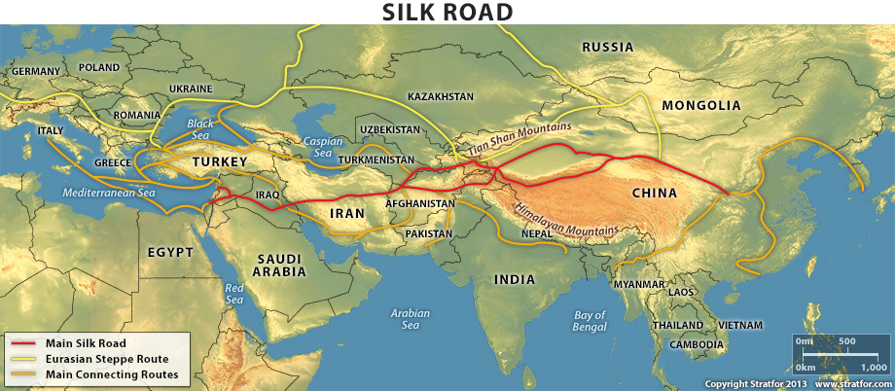
Silk Roads
Mongols expand empire to East Asia, open trade
Who was involved?
China
India
Persia and Central Asia
Europe
Mode of transportation
Camels
Other pack animals
What was exchanged?
Notes:
Exchange Items to discuss:
Asia - silk, porcelain, spices, precious woods, gems
Europe - wool cloth, gold, silver

Slide 6
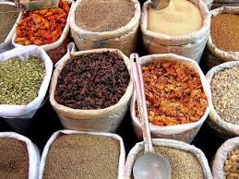
Silk Roads
Societal Impacts
Disease
Cultural Diffusion
Paper
Buddhism

Slide 7
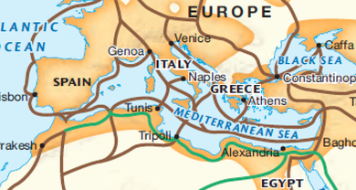
Mediterranean
Who was involved?
Cairo, Constantinople, Alexandria, Venice, Genoa, North Africa
Mode of Transportation
By Sea
Galleys - Boats with rowers
Overland
Caravans with pack animals
What was exchanged?
Notes:
Exchange Items to Discuss:
Europe - wool and linen cloth, wine, metal
North Africa - wool
Asia - spices, fruit, cloth

Slide 8
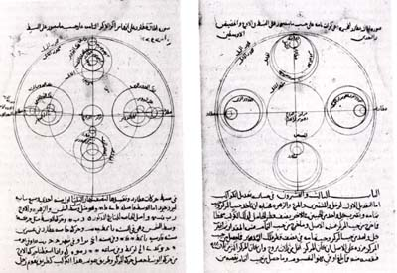
Mediterranean
Societal Impacts
Mathematics & Astronomy
From Southwest Asia to Europe
Wealth from North Africa

Slide 9
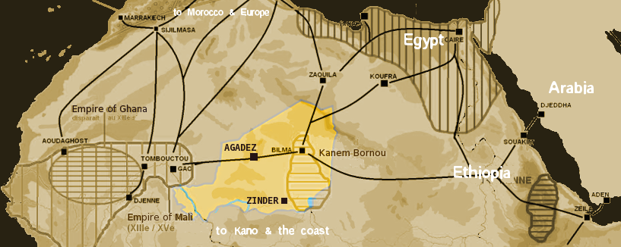
Trans-Saharan
Who was involved?
North Africa
West Africa
Mali
Mode of Transportation
Camel Caravans
What was exchanged?
Notes:
Exchange Items to Discuss:
North Africa - cloth, salt, horses, guns
West Africa - gold, dyed cloth, leather goods, slaves

Slide 10
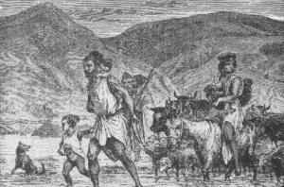
Trans-Saharan
Berbers
Spread of Islam throughout northern Africa
Civil wars
Beginnings of slave trade

Slide 11
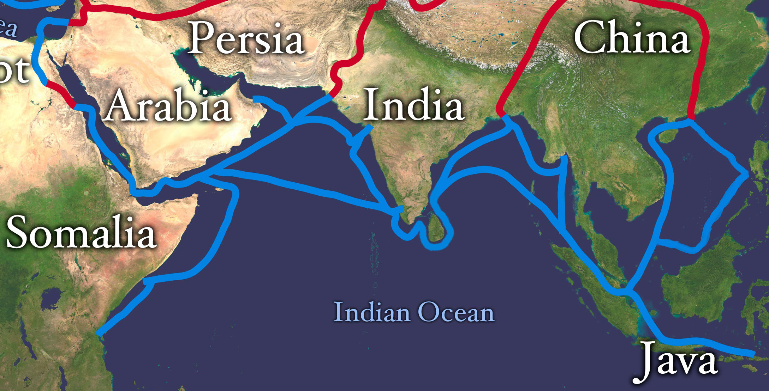
Indian Ocean
Who was involved?
China
India
East Africa
Southeast Asia
Arabia
Mode of Transportation
Dhows
What was exchanged?
Notes:
Exchange Items to discuss:
Asia - porcelain, silk, jewelry, cotton
East Africa - ivory, gold, tortoiseshell, leopard skins, salves

Slide 12
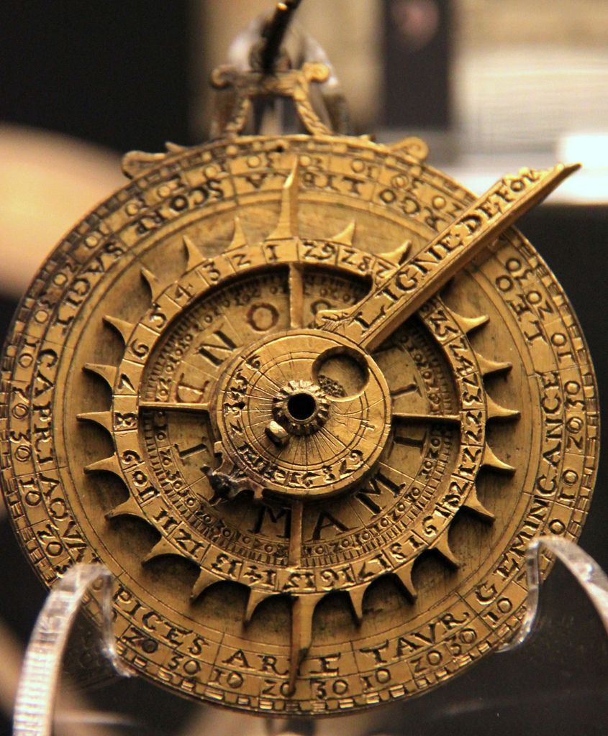
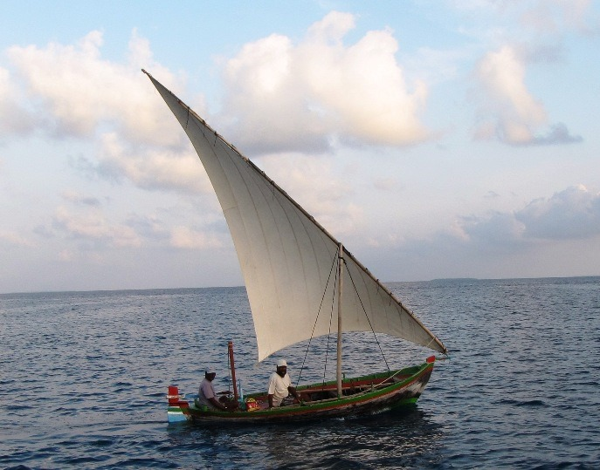
Indian Ocean
Societal Impacts
Growth of cosmopolitan cities
Increase of cultural tolerance
Lateen Sail
Astrolabe

