Slide 1
Survey of World Religions

Slide 2
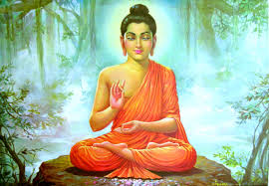
Buddhism
The Basics:
Began 2,500 years ago
Most followers live in East and Southeast Asia and in Japan.
362 Million followers worldwide.
Led by Buddhist monks and nuns.
Three Cardinal Faults: greed, hatred and delusion.

Slide 3
Buddhism
https://www.youtube.com/watch?v=Lxq-RiLb-6M

Slide 4
Buddhism
The Buddha is said to have ‘set in motion the wheel of dharma’ during his first sermon.
Taught that the key to happiness was detachment from worldly goods and desires.
This was done by following the Eightfold Path or the Middle Way…
Once you’ve completely detached yourself from these worldly things, you will have reached the state of Nirvana.

Slide 5
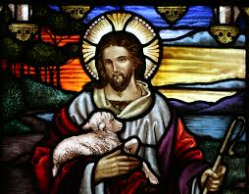
Christianity
The Basics:
The largest religion in the world with over 2 billion followers worldwide
Based on the life and teachings of Jesus Christ
Three Major Groups of Christians:
Roman Catholic
Eastern Orthodox
Protestant
Monotheistic religion
Led by multiple different offices depending on the division of Christianity that a person is a member of. Some of these leaders include: Priests, Monks, Nuns, Pastors, Reverends, the Pope, Cardinals, Bishops, etc…
Holy Book: the Bible
Deity: Monotheistic God

Slide 6
Christianity
https://www.youtube.com/watch?v=4Z6CArFTLmk

Slide 7
Christianity
Beliefs:
Jesus is the Son of God
Jesus entered the world to save it’s people from their own sins.
The Roman Crucifix is the symbol for the faith – it was on the cross that Christians believe that Christ died for the sins of the world.
To be saved and gain eternal life is to believe that Jesus Christ died for one’s sins and is the only Son of God.

Slide 8
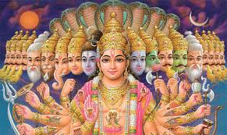
Hinduism
The Basics:
One of the worlds oldest religions and the major religion of India.
Hinduism is a collection of beliefs that have developed over thousands of years.
Hindus worship several gods, which represent different forms of Brahman. (Three main gods: Brahma, Vishnu and Shiva)
Brahman is the most divine spirit in the religion.
Leaders: Guru, holy man and Brahmin priest.

Slide 9
Hinduism
https://www.youtube.com/watch?v=9EICcU9oN-s

Slide 10
Hinduism
Beliefs:
One reaches enlightenment and happiness only once they release themselves from the trappings of the world and earthly desires.
Reincarnation is central to their belief system.
Dharma, Karma and Mokshu.

Slide 11
Islam
The Basics:
The worlds second largest religion with 1.2 billion followers.
Based on the teachings of the prophet Muhammad.
Two sects: Sunni and Shi’a
Divided based on their belief for the Caliph

Slide 12
Islam
https://www.youtube.com/watch?v=wgP_OSOS3IA

Slide 13
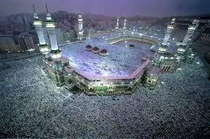
Islam
Beliefs:
God reveled the teachings to Muhammad through the angel Gabriel
Monotheistic – called Allah.
Holy Book: Qur’an
Believe in all of the prophets of Judaism and Christianity.
Leaders: Imams and Ulama (these people lead prayers)
Show devotion by performing lifelong acts of worship known as the Five Pillars of Islam.
Faith, prayer, almsgiving, fasting and a pilgrimage to Mecca.

Slide 14
Judaism
The Basics:
14 million Jews populate parts of the world, mostly located in Israel.
The oldest of the Monotheistic religions.
Holy Book – Torah
The founder of the religion was Abraham
The leaders in the religion are called Rabbis

Slide 15
Judaism
https://www.youtube.com/watch?v=xJbg_cXYFyM

Slide 16
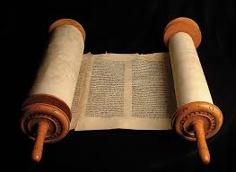
Judaism
Beliefs:
Only one God that watches over and cares for his people.
God loves and protects his people but holds people accountable for their actions.
Persons serve God by studying the Torah and living by its teachings.

Slide 17
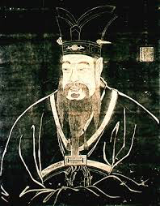
Confucianism
The Basics:
No clergy and no individual gods to worship
Not a religion – it’s a way of life, an ethical system that provides direction for personal behavior and good government.
But, since it guides over 6.3 million people throughout the world, it is often considered a religion.
Started by Confucius

Slide 18
Confucianism
Beliefs:
Social order, harmony and good government should be based on strong family relationships.
Respect for parents and elders is important to a well ordered society
Education is important in both the welfare of the individual and society.

